Slide 1
A quick review of E, R, C
What E does it have?
There are a number of Ex, each of which has attributes A1, A2, …, An, where Ai is unique
:::
What R does it have?
Ex and Ey participate in relationship R, which has attribute A1, …, An
:::
Any constraints on R?
At most and at least on an entity’s participation in a relationship
Uni-participation (at most one time
Total-participation (at least one time)
Key terms
Entity
Attribute
key attribute
Relationship
Constraint
Uni-participation
Total-participation

Slide 2
Three grammars for describing a database design
What E does it have?
There are a number of Ex, each of which has attributes A1, A2, …, An, where Ai is unique
:::
What R does it have?
Ex and Ey participate in relationship R, which has attribute A1, …, An
:::
Any constraints on R?
Ex can participate in a relationship R at most one time
Ex must participate in a relationship R at least one time
Ex must participate in a relationship R at least one time and only one time

Slide 3
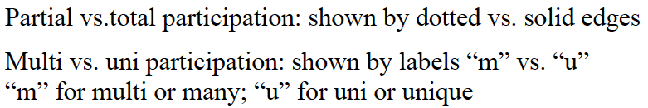
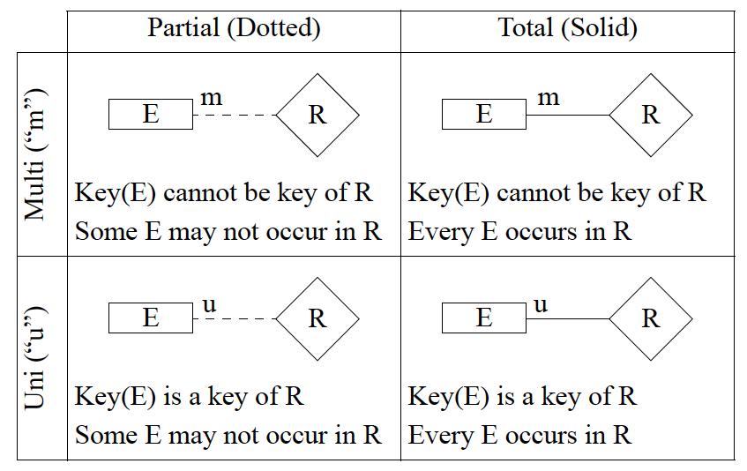
Notations used in this class

Slide 4
No standards on notations: Different notations may be used by different books, companies, or tools
Partial vs. total participation: shown by a thin line vs a thick line
Multi vs uni participation: shown by a line without vs with an arrow
Partial ( thin line)
Total ( thick line)
Multi ( no arrow)
R
E
R
E
Some E may not occur in R
Every E occurs in R
Uni (arrow)
E
R
E
R
An E may occur in R only once
Every E must occur in R and occur only once

Slide 5
Problem 1
Multiple entity sets participate
in a same relationship set
It records the relationships among students, instructors, and courses
students
instructors
teach/enroll
courses
instructors
teach
course
enroll
students
It records the relationships between instructors and courses, and the relationships between course and students, BUT not the relationships between instructors and students

Slide 6
Problem 2
Entity set or attribute
classroom
Here classroom is an attribute for relationship teach. It can have any value.
instructors
teach
courses
i1
i2
i1, c1, room1
i1, c2, roomX
c1
c2
r1
r2
Here classroom is an entity set, which has a number of members. Only these members can participate in relationship teach.
classroom
i1
i2
c1
c2
instructors
teach
courses
i1, c1, r1
i1, c2, r2

Slide 7
Problem 3
Constrains
m
m
student
register
club
m
m
student
register
club
u
m
student
register
club

Slide 8
E-R Model Exercises
Read an ER diagram
Draw an ER diagram

Slide 9
name
name
since
did
address
ssn
dob
m
m
Employees
works-in
Departments
Two entity sets:
Employees with attributes SSN, name, and dob, where SSN is unique
Departments with attributes did, name, address, where did is unique
One relationship set
“works-in” between Employees and Departments, with attribute since
Constraint
An employee can participate in “works-in” one or more times, or does not participate at all
multi- and partial participation
A department can participate in “works-in” one or more times, or does not participate at all
multi- and partial participation

Slide 10
name
name
since
did
address
ssn
dob
m
u
Employees
works-in
Departments
Two entity sets:
Employees with attributes SSN, name, and dob, where SSN is unique
Departments with attributes did, name, address, where did is unique
One relationship set
“works-in” between Employees and Departments, with attribute since
Constraint
An employee can participate in “works-in” one or more times, or does not participate at all
multi- and partial participation
A department can participate in “works-in” at most once
uni- and partial participation
Semantically: a department can have at most one employee

Slide 11
name
name
since
did
address
ssn
dob
m
u
Employees
works-in
Departments
Two entity sets:
Employees with attributes SSN, name, and dob, where SSN is unique
Departments with attributes did, name, address, where did is unique
One relationship set
“works-in” between Employees and Departments, with attribute since
Constraint
An employee can participate in “works-in” one or more times, or does not participate at all
multi- and partial participation
Every department must participate in “works-in” once and only once
uni- and total participation
Semantically: a department can have at most one employee and only one employee

Slide 12
name
name
since
did
address
ssn
dob
u
u
Employees
works-in
Departments

Slide 13
name
name
since
did
address
ssn
dob
u
u
Employees
works-in
Departments
Two entity sets:
Employees with attributes SSN, name, and dob, where SSN is unique
Departments with attributes did, name, address, where did is unique
One relationship set
“works-in” between Employees and Departments, with attribute since
Constraint
An employee can participate in “works-in” at most one time
uni- and partial participation
Semantically: an employee can work in at most one department
Every department must participate in “works-in” once and only once
uni- and total participation
Semantically: a department can have at most one employee and only one employee

Slide 14
Drawing ER diagram
What entity sets?
attributes, key attribute
What relationship sets?
attributes
ISA?
What constraints?
uni- vs. multi-participation
total vs. partial participation

Slide 15
Exercise 1
A company has a number of employees. The attributes of EMPLOYEE include Employee_ID (identifier), Name, Address, and Birthdate.
The company also has several projects. Attributes of PROJECT include Project_ID (identifier), Project_Name, and Start_Date.
Each Employee may be assigned to one or more projects, or may not be assigned to a project.
A project must have at least one employee assigned, and may have any number of employees assigned.
An employee’s billing rate may vary by project, and the company wishes to record the applicable billing rate (Billing_Rate) for each employee when assigned to a particular project.

Slide 16
Exercise 2
A university has a large number of courses in its catalog. Attributes of COURSE include Course_number (identifier), Course_name, and Units.
Each course may have one or more different courses as prerequisites, or may have no prerequisites. Similarly, a particular course may be a prerequisite for any number of courses, or may not be prerequisite for any other course.

Slide 17
Exercise 2’
There are a number of people, attributes of which include SSN, name, and gender.
A person may have to do with another person, e.g., sharing common interests such as fishing, soccer, and so on.
Is this ER-diagram efficient to implement? How about searching of all persons who have to do with a given person?
An alternative solution: using each person’s id as a table name and let the table store the people s/he has to do with and the relationship.
Yet this is no longer an ER diagram
Another solution is Graph model (e.g., Neo4J)

Slide 18
Exercise 3
A hospital has a large number of registered physicians and patients.
Attributes of PHYSICIAN include Physician_ID (identifier) and Specialty.
Attributes of Patients include Patient_ID (identifier) and Patient_Name.
Any patient who is admitted must have exactly one admitting physician. A physician may optionally admit any number of patients.
Once admitted, a given patient must be treated by at least one physician. A particular physician may treat any number of patients, or may not treat any patients.
Whenever a patient is treated by a physician, the hospital wishes to record the details of the treatment (Treatment_Detail). Components of Treatment_Detail include Date, Time, and Results.

Slide 19
A quick review
Q1: What E does it have?
Q2: What R does it have?
Q3: Any constraints on R?
Uni-participation vs. multi-participation
Total-participation vs. partial-participation
One more question, a special kind of relationship :
Q4: Is there any relationship that is ISA?

Slide 20
ISA (`is a’) Hierarchies
If we declare A ISA B, every A entity is also considered to be a B entity.
Reasons for using ISA:
To add attributes specific to a subclass.
To identify entities that participate in a relationship.
name
ssn
lot
Employees
hourly_wages
hours_worked
ISA
contractid
Hourly_Emps
Contract_Emps
Overlap constraints:
Can Joe be an Hourly_Emps as well as a Contract_Emps entity? (Allowed/disallowed)
Default value: no overlap;
Otherwise, write Hourly_Emps OVERLAPS Contract_emps
Covering constraints:
Does every Employees entity also have to be an Hourly_Emps or a Contract_Emps entity? (Yes/no)
Default value: no;
Otherwise write Hourly_Emps and Contract_Emps COVER Employees

Slide 21
Exercise 4
A university has a number of people
attributes: SSN, name, address
A person can be a faculty, a student, a staff
faculty attributes: rank, salary, research areas, grants
student attributes: first enrollment date, gpa
staff attributes: rank, salary, specialty
A person must be either a faculty, a student, and/or a staff
A student can be a staff and vice versa
A facutly can be a student and vice versa

Slide 22
Exercise 5
Construct an E-R diagram for the instructor of the COMS DB course to record the following information.
The instructor has a number of students and a number of teaching assistants (TAs)
Each student has SSN, CName, and Email
Each TA has a TName and Email
Each student is assigned with one and only one TA as his/her primary TA
A TA may or may not have any student
The course has a number of tasks (e.g., homework, project, exam), each of which has a TaskName, DueDate, and Points
A student may take several tasks and each task must be graded by at least one TA. The date that a student submits a task and the points they receive must be recorded.

Slide 23
ER design is subjective. There are often many ways to model a given scenario!
Analyzing alternatives can be tricky, especially for a large enterprise. Common choices include:
Entity vs. attribute, entity vs. relationship, binary or n-ary relationship, whether or not to use ISA hierarchies, and whether or not to use aggregation.
ER diagrams can use different notations, but use the same concept.
Several software tools are available for creating ER diagrams: IBM Rational Rose, Microsoft Visio
Question to think
Is there anything that cannot be described by ER model?

